Slide 1
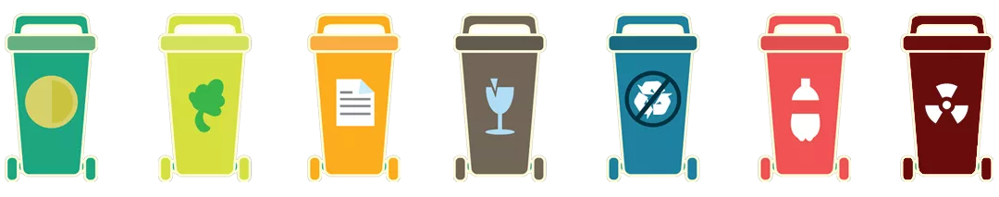
Waste Classification Using Images
Group 20

Slide 2
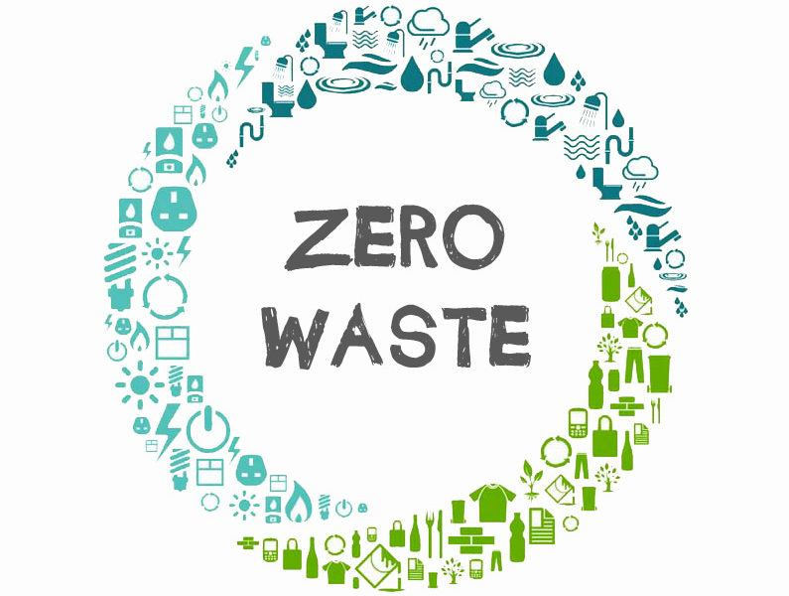
Objective
We aim to approach the problem of classifying waste materials into various waste classes such as type of waste, biodegradable or non biodegradable and recyclable or non recyclable using image classification

Slide 3
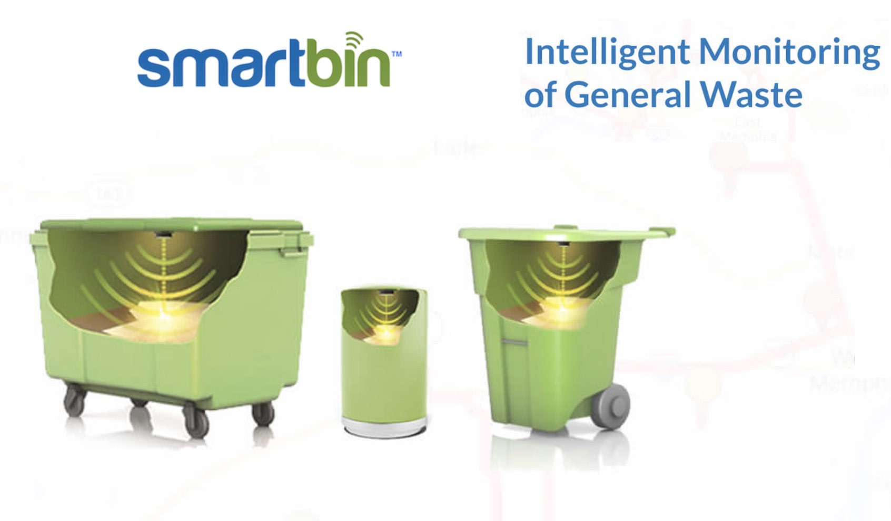
Motivation
Automated classification of waste by intelligent systems enables effective and efficient management of waste
Waste recycling converts waste into a resource
Reduce the amounts of waste dumped into the landfills
Consumer level awareness about the waste generated and its proper segregation

Slide 4
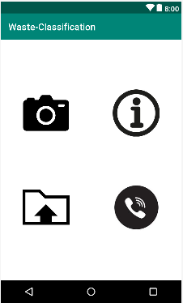
Methodology
Created database for training of Neural network through manual data mining - collected 25 images for each class
Trained a convolutional neural network on the Cloud IBM Watson Server invoked using API calls via bash
Designed consumer user interfaces using Android Studio
Invoked IBM Watson for inference of test data through API calls via Flask

Slide 5
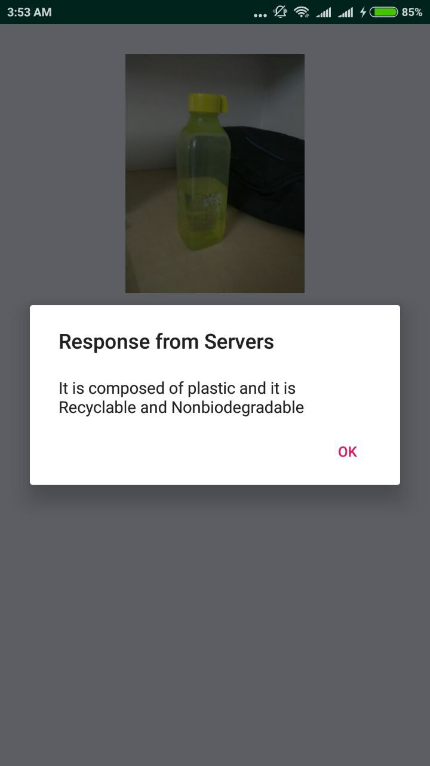
Results
Categorization of object as belonging
to the following classes
Cardboard
Food
Metal
Paper
Plastic
Segregation of object as being
biodegradable or non biodegradable
Determining if the object can be recyclable or not

Slide 6
Applications
Hassle-free waste segregation that helps in
Efficient resource utilization, promoting sustainability
Proper waste disposal to reduce waste mixing hence pollution
Easy guide to waste classification
Interactive user platform to create awareness about waste management

